Slide 1
AWSTemplateFormatVersion: '2010-09-09'
Metadata:
License: Apache-2.0
Parameters:
HashKeyElementName:
Description: HashType PrimaryKey Name
Type: String
AllowedPattern: '[a-zA-Z0-9]*'
MinLength: '1'
MaxLength: '2048'
ConstraintDescription: must contain only alphanumberic characters
HashKeyElementType:
Description: HashType PrimaryKey Type
Type: String
Default: S
AllowedPattern: '[S|N]'
MinLength: '1'
MaxLength: '1'
ConstraintDescription: must be either S or N
ReadCapacityUnits:
Description: Provisioned read throughput
Type: Number
Default: '5'
MinValue: '5'
MaxValue: '10000'
ConstraintDescription: must be between 5 and 10000
WriteCapacityUnits:
Description: Provisioned write throughput
Type: Number
Default: '10'
MinValue: '5'
MaxValue: '10000'
ConstraintDescription: must be between 5 and 10000
Resources:
myDynamoDBTable:
Type: AWS::DynamoDB::Table
Properties:
AttributeDefinitions:
- AttributeName: !Ref 'HashKeyElementName'
AttributeType: !Ref 'HashKeyElementType'
KeySchema:
- AttributeName: !Ref 'HashKeyElementName'
KeyType: HASH
ProvisionedThroughput:
ReadCapacityUnits: !Ref 'ReadCapacityUnits'
WriteCapacityUnits: !Ref 'WriteCapacityUnits'
Outputs:
TableName:
Value: !Ref 'myDynamoDBTable'
Description: Table name of the newly created DynamoDB table
Resources:
TableOfBooks:
Type: AWS::DynamoDB::Table
Properties:
AttributeDefinitions:
- AttributeName: Title
AttributeType: S
- AttributeName: Category
AttributeType: S
- AttributeName: Language
AttributeType: S
KeySchema:
- AttributeName: Category
KeyType: HASH
- AttributeName: Title
KeyType: RANGE
ProvisionedThroughput:
ReadCapacityUnits: !Ref 'ReadCapacityUnits'
WriteCapacityUnits: !Ref 'WriteCapacityUnits'
LocalSecondaryIndexes:
- IndexName: LanguageIndex
KeySchema:
- AttributeName: Category
KeyType: HASH
- AttributeName: Language
KeyType: RANGE
Projection:
ProjectionType: KEYS_ONLY
GlobalSecondaryIndexes:
- IndexName: TitleIndex
KeySchema:
- AttributeName: Title
KeyType: HASH
Projection:
ProjectionType: KEYS_ONLY
ProvisionedThroughput:
ReadCapacityUnits: !Ref 'ReadCapacityUnits'
WriteCapacityUnits: !Ref 'WriteCapacityUnits'
Outputs:
TableName:
Value: !Ref 'TableOfBooks'
Description: Name of the newly created DynamoDB table
# The task definition. This is a simple metadata description of what
# container to run, and what resource requirements it has.
TaskDefinition:
Type: AWS::ECS::TaskDefinition
Properties:
Family: !Ref 'ServiceName'
Cpu: !Ref 'ContainerCpu'
Memory: !Ref 'ContainerMemory'
NetworkMode: awsvpc
RequiresCompatibilities:
- FARGATE
ExecutionRoleArn:
Fn::ImportValue:
!Join [':', [!Ref 'StackName', 'ECSTaskExecutionRole']]
TaskRoleArn:
Fn::If:
- 'HasCustomRole'
- !Ref 'Role'
- !Ref "AWS::NoValue"
ContainerDefinitions:
- Name: !Ref 'ServiceName'
Cpu: !Ref 'ContainerCpu'
Memory: !Ref 'ContainerMemory'
Image: !Ref 'ImageUrl'
PortMappings:
- ContainerPort: !Ref 'ContainerPort'
# The service. The service is a resource which allows you to run multiple
# copies of a type of task, and gather up their logs and metrics, as well
# as monitor the number of running tasks and replace any that have crashed
Service:
Type: AWS::ECS::Service
DependsOn: LoadBalancerRule
Properties:
ServiceName: !Ref 'ServiceName'
Cluster:
Fn::ImportValue:
!Join [':', [!Ref 'StackName', 'ClusterName']]
LaunchType: FARGATE
DeploymentConfiguration:
MaximumPercent: 200
MinimumHealthyPercent: 75
DesiredCount: !Ref 'DesiredCount'
NetworkConfiguration:
AwsvpcConfiguration:
AssignPublicIp: ENABLED
SecurityGroups:
- Fn::ImportValue:
!Join [':', [!Ref 'StackName', 'FargateContainerSecurityGroup']]
Subnets:
- Fn::ImportValue:
!Join [':', [!Ref 'StackName', 'PublicSubnetOne']]
- Fn::ImportValue:
!Join [':', [!Ref 'StackName', 'PublicSubnetTwo']]
TaskDefinition: !Ref 'TaskDefinition'
LoadBalancers:
- ContainerName: !Ref 'ServiceName'
ContainerPort: !Ref 'ContainerPort'
TargetGroupArn: !Ref 'TargetGroup'
# A target group. This is used for keeping track of all the tasks, and
# what IP addresses / port numbers they have. You can query it yourself,
# to use the addresses yourself, but most often this target group is just
# connected to an application load balancer, or network load balancer, so
# it can automatically distribute traffic across all the targets.
TargetGroup:
Type: AWS::ElasticLoadBalancingV2::TargetGroup
Properties:
HealthCheckIntervalSeconds: 6
HealthCheckPath: /
HealthCheckProtocol: HTTP
HealthCheckTimeoutSeconds: 5
HealthyThresholdCount: 2
TargetType: ip
Name: !Ref 'ServiceName'
Port: !Ref 'ContainerPort'
Protocol: HTTP
UnhealthyThresholdCount: 2
VpcId:
Fn::ImportValue:
!Join [':', [!Ref 'StackName', 'VPCId']]
# Create a rule on the load balancer for routing traffic to the target group
LoadBalancerRule:
Type: AWS::ElasticLoadBalancingV2::ListenerRule
Properties:
Actions:
- TargetGroupArn: !Ref 'TargetGroup'
Type: 'forward'
Conditions:
- Field: path-pattern
Values: [!Ref 'Path']
ListenerArn:
Fn::ImportValue:
!Join [':', [!Ref 'StackName', 'PublicListener']]
Priority: !Ref 'Priority'
Infrastructure
as Code

Slide 2
I need a MySQL database and a load balancer for my application in production

Slide 3
I’m installing MySQL, anything wrong?
$ ssh ec2-user@10.180.18.171
The authenticity of host '10.180.18.171 (10.180.18.171)' can't be established.
ECDSA key fingerprint is SHA256:T/JmW5xqkVdhZxHO37LsNxtb8KHFN6FxSqazY3ibaIU.
ECDSA key fingerprint is MD5:d1:70:5a:1a:28:82:fe:32:ac:1c:b4:28:f9:e2:5d:5c.
Are you sure you want to continue connecting (yes/no)? yes
Warning: Permanently added '10.180.18.171' (ECDSA) to the list of known hosts.
__| __| __|
_| ( \__ \ Amazon Linux 2 (ECS Optimized)
____|\___|____/
For documentation, visit http://aws.amazon.com/documentation/ecs
[ec2-user@ip-10-180-18-171 ~]$ sudo apt-get install mysql-server
Reading package lists... Done
Building dependency tree
Reading state information... Done
The following additional packages will be installed:
libaio1 libcgi-fast-perl libcgi-pm-perl libedit2 libencode-locale-perl libevent-core-2.1-6 libfcgi-perl libgdbm-compat4 libgdbm5 libhtml-parser-perl libhtml-tagset-perl libhtml-template-perl libhttp-date-perl libhttp-message-perl libio-html-perl liblwp-mediatypes-perl
libnuma1 libperl5.26 libtimedate-perl liburi-perl libwrap0 mysql-client-5.7 mysql-client-core-5.7 mysql-common mysql-server-5.7 mysql-server-core-5.7 netbase perl perl-modules-5.26 psmisc
Suggested packages:
gdbm-l10n libdata-dump-perl libipc-sharedcache-perl libwww-perl mailx tinyca perl-doc libterm-readline-gnu-perl | libterm-readline-perl-perl make
The following NEW packages will be installed:
libaio1 libcgi-fast-perl libcgi-pm-perl libedit2 libencode-locale-perl libevent-core-2.1-6 libfcgi-perl libgdbm-compat4 libgdbm5 libhtml-parser-perl libhtml-tagset-perl libhtml-template-perl libhttp-date-perl libhttp-message-perl libio-html-perl liblwp-mediatypes-perl
libnuma1 libperl5.26 libtimedate-perl liburi-perl libwrap0 mysql-client-5.7 mysql-client-core-5.7 mysql-common mysql-server mysql-server-5.7 mysql-server-core-5.7 netbase perl perl-modules-5.26 psmisc
0 upgraded, 31 newly installed, 0 to remove and 9 not upgraded.
Need to get 27.8 MB of archives.
After this operation, 204 MB of additional disk space will be used.
Do you want to continue? [Y/n] Y
Get:1 http://archive.ubuntu.com/ubuntu bionic/main amd64 mysql-common all 5.8+1.0.4 [7308 B]

Slide 4
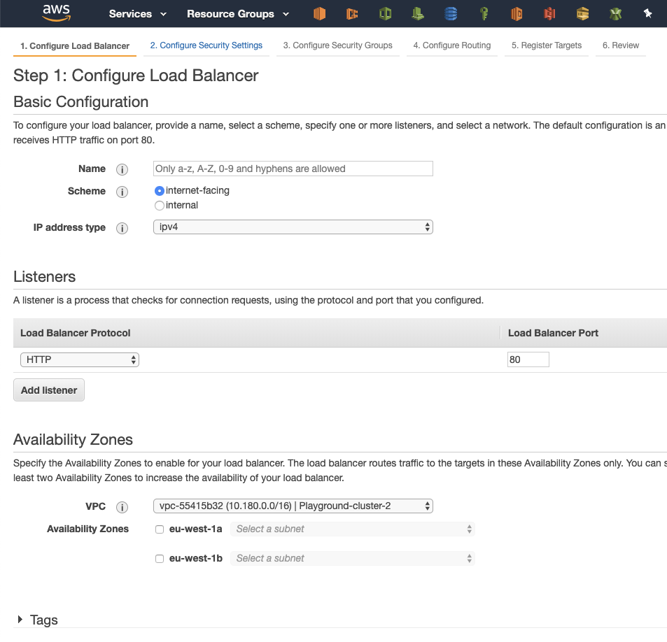
I creating a load balancer, anything wrong?

Slide 6
Snowflake
Unique
Can’t be reproduced
Can’t automate
Expensive to set up
Expensive to maintain
No (or little) traceability

Slide 7
What to we want then?
We want recipes for all our infrastructure
We want the recipes to version controlled
We want to automatize the application of the recipes

Slide 8
We want infrastructure as code

